Slide 1
ITSE 4931: Operating Systems
Lisanu Tebikew
lisanu@gmail.com
Lecture 1: Introduction
Oct 7, 2013

Slide 2
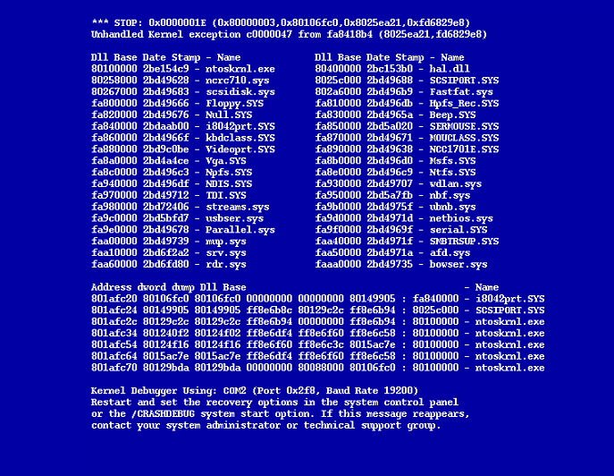
Welcome to ITSE 2154 !

Slide 3
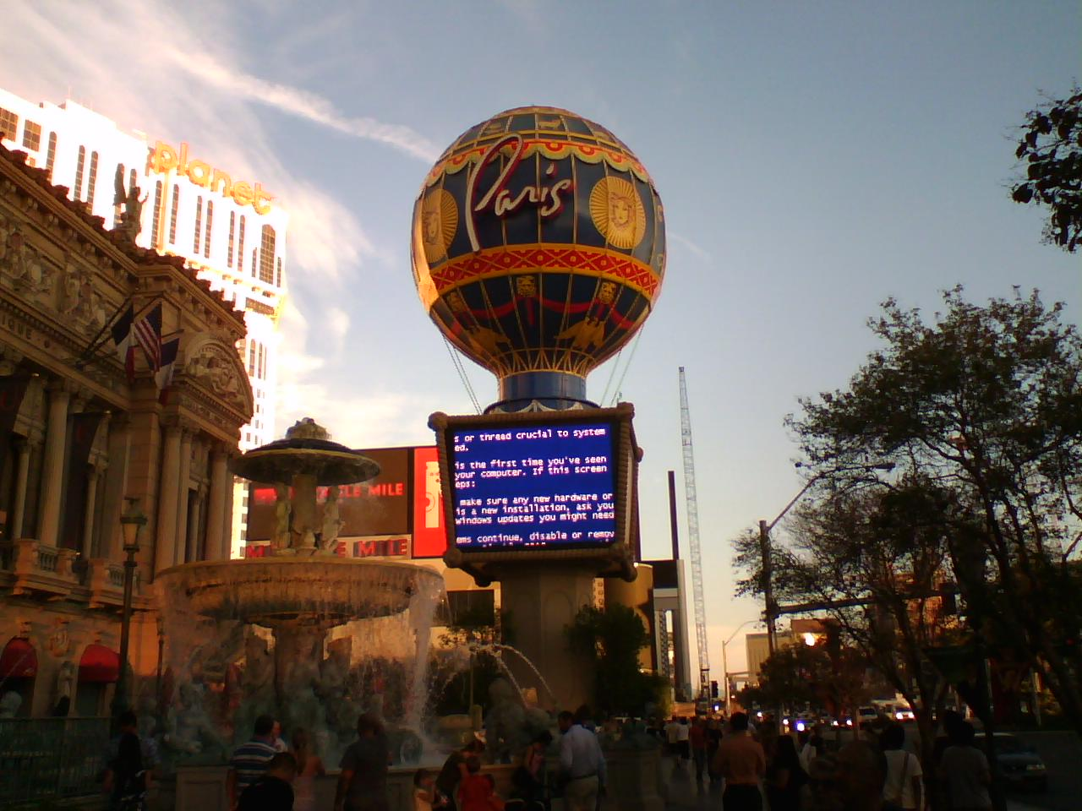

Slide 4
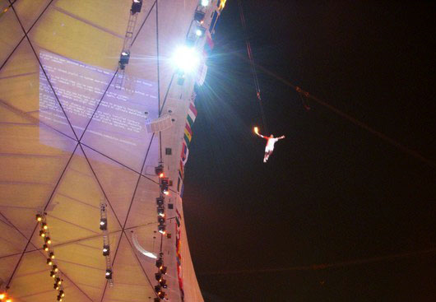

Slide 5

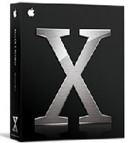
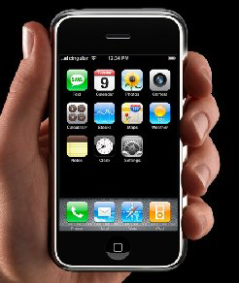
Welcome to ITSE 4931!
What is this course about?
Operating Systems drive the inner workings of virtually every computer in the world today
PCs, servers, iPods, cell phones, missile guidance systems, etc. all have an OS that dictate how they operate.
The OS manages many aspects of how programs run, and how they interact with hardware and the outside world.

Slide 6
High-level Objectives
Learn how an OS works
OS are essential to everything we do with computers
Get an inside view (“internal perspective”)
Look at design & implementation

Slide 7
About Me
Name: Lisanu Tebikew
Undergraduate in CS at Bahir Dar University
MSc in CS at Addis Ababa University
2nd Year at AAIT as Lecturer
4rd time teaching OS
Research Interests:
Operating systems, distributed systems, Computer Security, Image Processing, Enterprise software architectures.

Slide 8
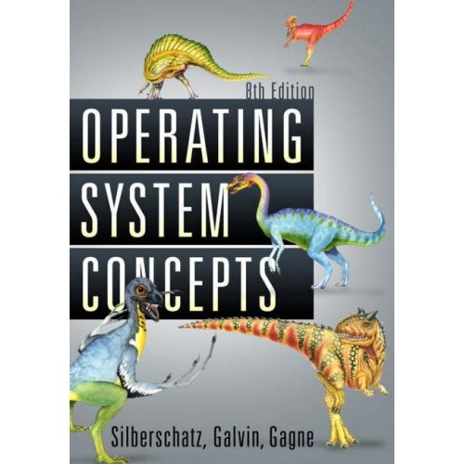
Reading Material
Required Textbook
Silberschatz, Galvin, Gagne: Operating Systems Concepts (8th Edition), 2008
7th may be ok
Will post reading assignments

Slide 9
Class Format
Lectures
Interactive
Exams
1 Midterm
1 Final (Comprehensive)
2 Quizzes
Exams are only offered at the announced time. Missed exams result in zero score.
Labs
TBD
~50% of your final grade.

Slide 10
Prerequisites
Willingness to master the subject
Knowledge of computer organization helps
Addressing, Registers, Basic Assembly Language, Memory Organization
I will revise the major aspects today.
Knowledge of algorithms & data structures
Solid knowledge of linked lists, hash tables, etc.
Solid knowledge of C

Slide 11
Acknowledgements
Will draw in lectures from
Silberschatz et al’s book (“Dinosaur book”)
And other texts, in particular
Tannenbaum’s Operating Systems Design and Implementation
Tannenbaum’s Modern Operating Systems
Randal E. Bryant, David R. O’Hallaron. Computer Systems: A Programmers Perspective
Course material created in other courses
E.g., CS140 @ Stanford, CS 161@ Harvard, CS 162 @ UC Berkeley,

Slide 12
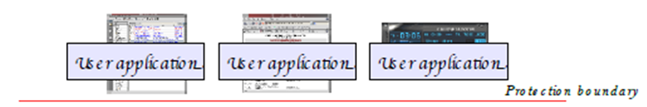
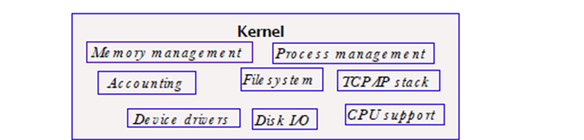
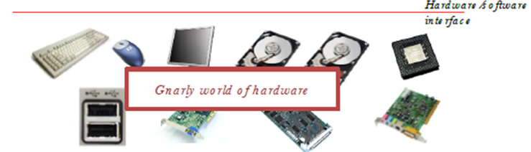
What is an operating system?
Resource allocator
Notes:
Looked at OS's role from the views of the user and system.
How can we define?
Goal 1.
Make solving user problems easier – Hardware is constructed
Hardware not easy to use – So Application programs are developed
Programs require Common Operations e.x Reading to a file,… → Don’t reinvent the wheel; Bring all in one (called an OS)

Slide 13
Today
(Previous) What is an operating system?
(Next) Computer-System Operation
(Later) Computer-System Organization

Slide 14
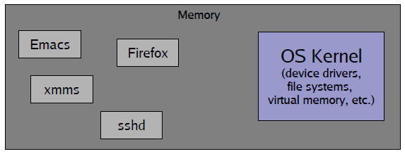
What is an operating system?
OS is just a bunch of code that sits around in memory, waiting to be executed.
But who puts it in memory and starts it?
How is it called to do an activity?
Notes:
0-. No definition of what is part of an OS
1+. Small vs. large
1++. Microsoft’s Monopoly
2+. Usually called the kernel

Slide 15
Computer-System Operation
OS is just a bunch of code that sits around in memory, waiting to be executed.
But who puts it in memory and starts it?
When a PC is booted:
Startup code (a.k.a bootstrap program) in ROM (BIOS) loads boot sector (Floppy, hard disk or USB flash disk) and jumps to it.
You might need to change your home machine’s BIOS setup to let it boot from USB flash disk first.
Older machines might not support boot from USB flash disk.
Boot sector code loads OS kernel (start at sector:2) and jumps to it.
What is the first OS process started?
Hint: it is the root process.
Answer: init
Init then forks other children.

Slide 16
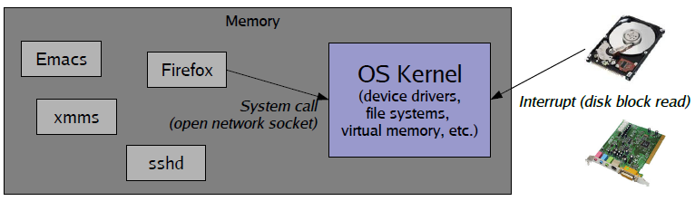
Computer-System Operation
OS is just a bunch of code that sits around in memory, waiting to be executed.
But who puts it in memory and starts it?
How is it called to do an activity?
OS is triggered in two ways
System call: Direct “call” from a user program (software)
For example, open() to open a file, or exec() to run a new program
Hardware interrupt: Signal from hardware device to CPU through bus
For example, when a disk block has been read or written

Slide 17
Interrupts – a primer
An interrupt is a signal that causes the CPU to jump to a pre-defined instruction – called the interrupt handler
Interrupt can be caused by hardware or software
Hardware interrupt examples
Timer interrupt (periodic “tick”)
Device interrupts
e.g., Disk will interrupt the CPU when an I/O operation has completed
Software interrupt examples (also called exceptions)
Division by zero error
Access to a bad memory address
Intentional software interrupt – e.g., x86 “INT” instruction
Can be used to trap from user program into the OS kernel!

Slide 18
Interrupt handler
OS initializes interrupt handler table in memory (usually at boot time)
Interrupt has a unique number k
k contains the address of the handler code for exception k
Processor detects an event has occurred
Save the state of the CPU Eg. address of the interrupted instruction, registers
Disables Incoming interrupts
Determines interrupt number k and Handler k is called
Restore saved CPU state.
Interrupt
numbers
code for
interrupt handler 0
Interrupt
Handler
Table
code for
interrupt handler 1
0
1
code for
interrupt handler 2
2
...
n-1
...
code for
interrupt handler n-1

Slide 19
Today
(Previous) Computer-System Operation
(Next) Computer-System Organization
(Later) Operating-System Structure

Slide 20
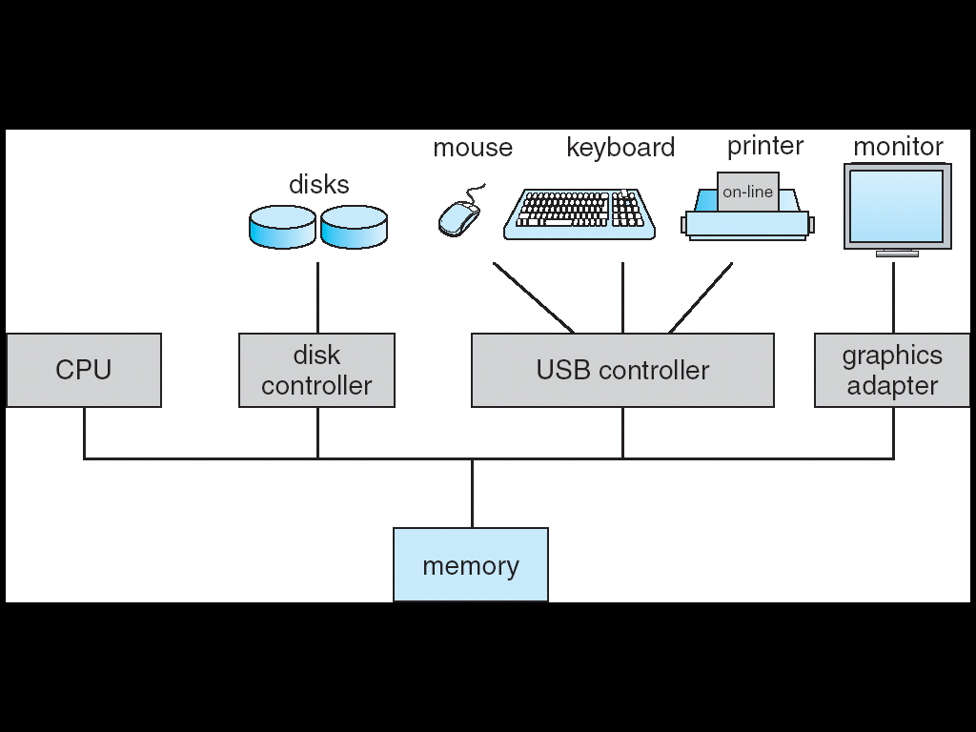
Computer System Organization
CPU, Input, Output, Storage, and Memory
Components Connected through Bus

Slide 21
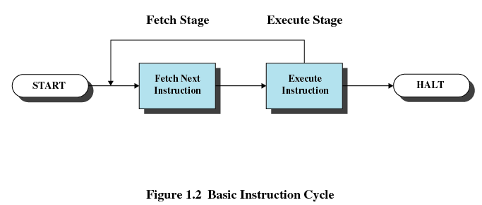
Storage Structure
Main memory (DRAM) stores programs and data during program execution
Two steps in instruction-execution cycle (Von Neumann)
Processor reads instructions from memory
Fetches
Processor executes each instruction
Each CPU has a specific set of instructions.
Notes:
instruction-execution cycle, as executed on a system with a von Neumann architecture

Slide 22
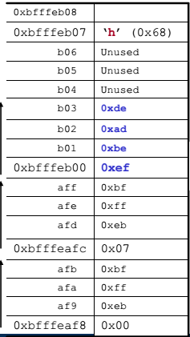
Main memory
CPU can access directly access Main memory
Forms a large array of bytes (1 byte = 8 bits) of memory, each with its own address
we say that main memory is byte – addressable
Main memory (DRAM) cannot store all programs and permanently.
Volatile – Loses its contents
Small – Not enough to store all needed programs and data.
Secondary storage: hold large quantities of data (including programs) permanently
Loaded into memory only when needed (when user starts the program).

Slide 23
Registers
Accessing memory to get instruction and data is slow
Needs work space in CPU: registers
Minimize main-memory references
User-visible registers
In x86 four 16-bit data registers: AX, CX, DX, BX
In x86 each in two 8-bit halves, e.g. AH and AL
Control and Status Registers
Program Counter (PC) – the address of an instruction to be fetched
Instruction Register (IR) – the instruction most recently fetched
Program Status Word (PSW) –Condition codes, Interrupt enable/disable, Supervisor/user mode
Condition Codes or Flags
Bits set by the processor hardware as a result of operations
Positive result, Negative result, Zero, Overflow

Slide 24
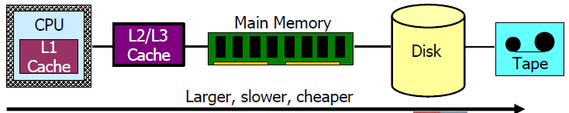
Storage Hierarchy
Processor registers, main memory, and auxiliary memory form a rudimentary memory hierarchy
The hierarchy can be classified according to memory speed, cost, and volatility
Caches can be installed to hide performance differences.
Copying information into faster storage system.
Can main memory be viewed as a cache for secondary memory?

Slide 25
I/O Structure
Has registers to accept command (read, on/off)
Controller manages devices
Controller has buffer
Bus Connects CPU and Controllers
Notes:
CPU moves data from/to main memory to/from the local buffers.
I/O is from the device to local buffer of controller.
Device controller informs CPU that it has finished its operation by causing an interrupt.

Slide 26
I/O Structure – Interrupt Driven
Has registers to accept command (read, on/off)
Controller manages devices
Controller has buffer
Bus Connects CPU and Controllers
Controller sends Interrupt to CPU
+ Bytes of data to CPU
Notes:
CPU moves data from/to main memory to/from the local buffers.
I/O is from the device to local buffer of controller.
Device controller informs CPU that it has finished its operation by causing an interrupt.

Slide 27
I/O Structure – DMA (Direct Memory Access)
Has registers to accept command (read, on/off)
Controller manages devices
+ DMA Controller
Controller has buffer
Bus Connects CPU and Controllers
Controller sends Interrupt to CPU
+ Bytes of data to MEMORY
Notes:
Interrupt Driven I/O wastes time for large data E.g Disk I/O
One interrupt per block; not bite

Slide 28
Admin Stuff
Next Lecture: Operating System Structures
Reading for Lecture 1 Silberschatz Chapter 1

